Slide 1



Travel
Tide
Home
Tours Page
News
Contact
A Roadmap to Enhanced Loyalty
Customer Segmentation with Data-Driven Approach
Tsai-Shiou Hsieh
September 2024

Slide 2




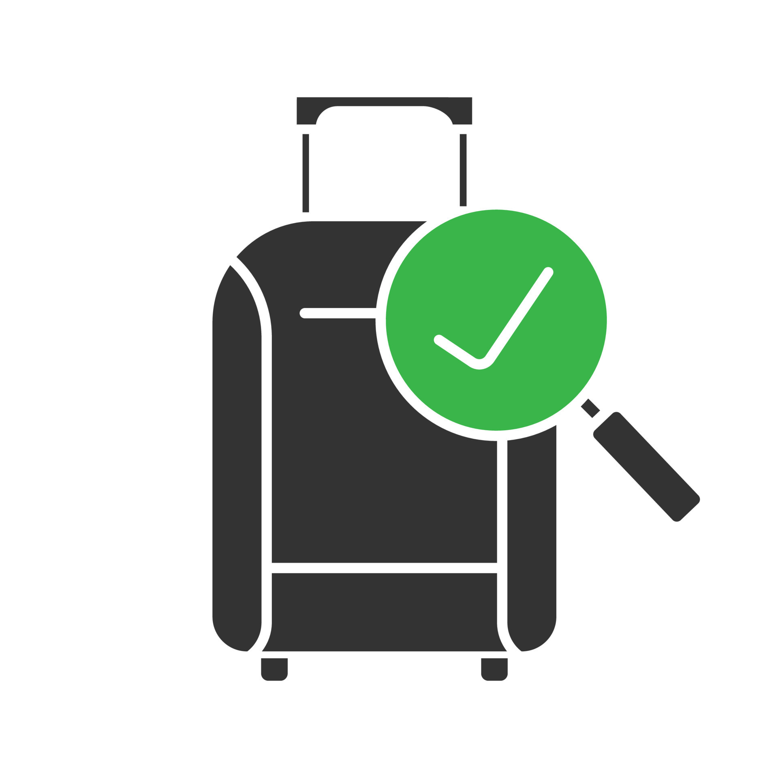



Travel
Tide
Introduction
Reward
Program
Free Hotel Night with Flight
Free Checked Bag
No Cancellation Fees
Exclusive Discount
Free Hotel Meal

Slide 3
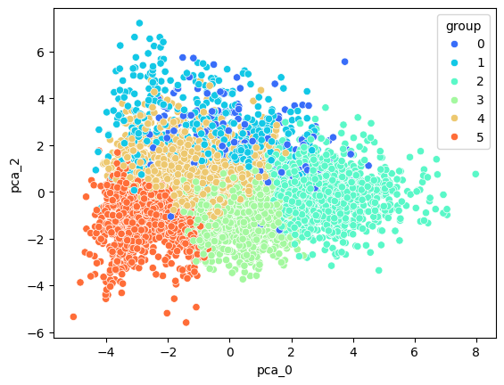

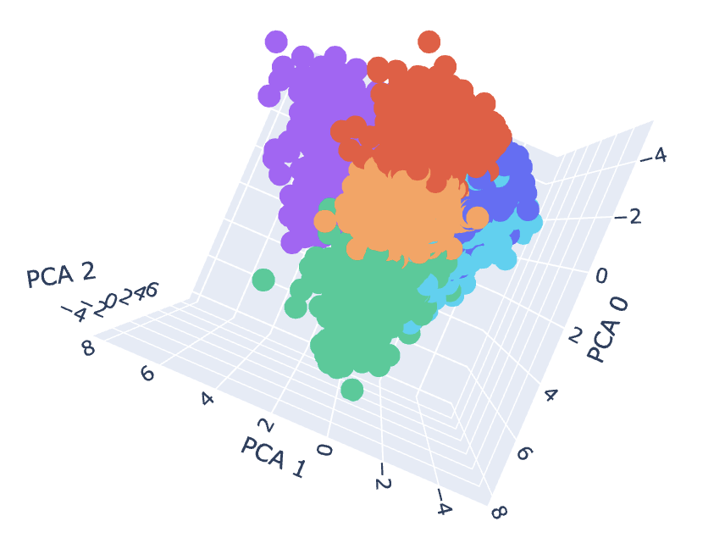
Travel
Tide
Methodology
Cohort
2023-01-05 to 2023-07-29
At least 8 sessions
5998 Customers
Cohort
2023-01-05 to 2023-07-29
At least 8 sessions
5998 Customers
Data Analysis
SQL + Python
Unsupervised Machine Learning
Scaling -> PCA -> k-Means Clustering
Notes:
Approach: Used unsupervised machine learning to identify customer segments.
Data Analyzed: Demographics, purchasing behavior, and browsing activity.
Outcome: Six distinct customer segments were identified.
Visual: Flowchart showing the steps—data collection → clustering → segment identification.

Slide 4

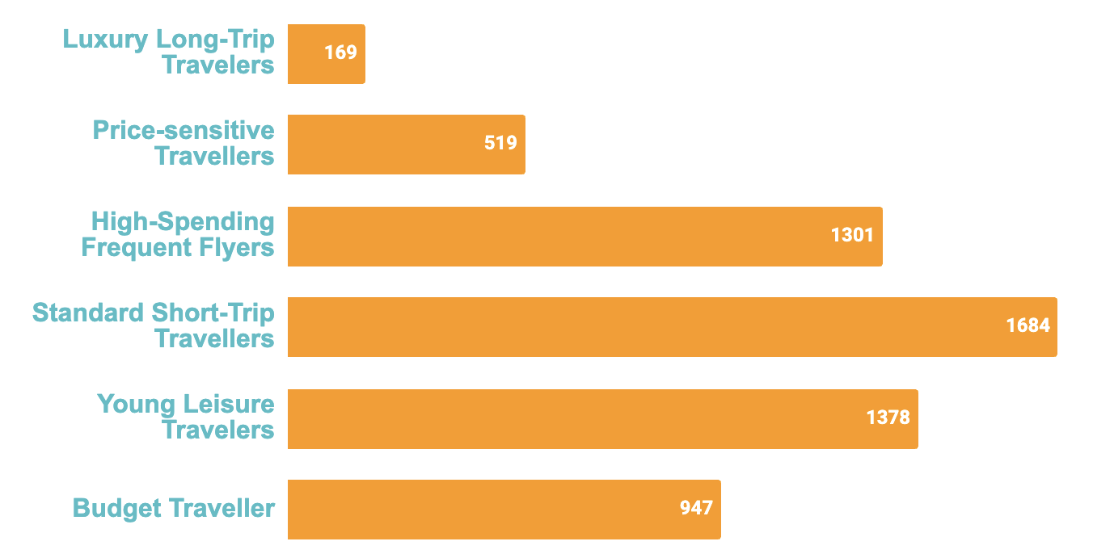
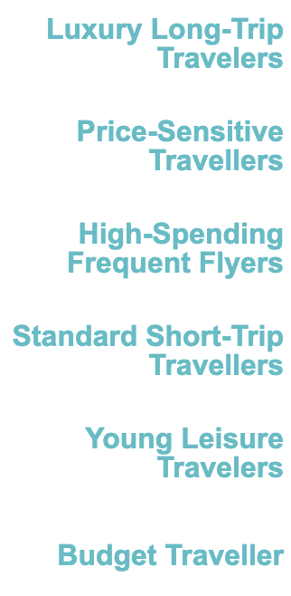
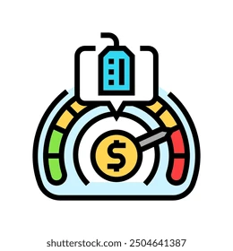




Travel
Tide
Key Findings
Segments
6 Customer
 | Trip length +++ Total & Per-Trip Spending +++ Flight Distance +++
 | Page-Clicks & Session Duration +++ Cancellation Rate +++ Recent Booking - -
 | No. of Flights: & Trips +++ Purchase Rate +++ Total Spending +++
 | Trip Length - - - Total & Per-Trip Spending: - - Age: ++
 | Trip length ++ Total & Per-Trip Spending: ++ Age: - -
 | No. of Flights & Trips: - - - Trip Length: - - Total & Per-Trip Spending - - -
Notes:
Slide 4: Key Findings
Segment Overview:
Group 0: Luxury Long-Trip Travelers
Group 1: Price-Sensitive Frequent Flyers
Group 2: High-Spending Frequent Flyers
Group 3: Standard Frequent Travelers
Group 4: Leisure-Focused Travelers
Group 5: Budget-Conscious Travelers
Visual: Pie chart or bar graph showing the size of each segment.

Slide 5
Travel
Tide
Assigned Perks
Assigned PERKS
High-Spending Frequent Flyers | Luxury Long-Trip Travelers | Young Leisure Travelers | Standard Short-Trip Travellers | Price-sensitive Travellers | Budget Traveller
Free Hotel Night with Flight
Free Checked Bag
No Cancellation Fees
Package Discount
Free Hotel Meal
Notes:
Slide 4: Key Findings
Segment Overview:
Group 0: Luxury Frequent Travelers
Group 1: Price-Sensitive Frequent Flyers
Group 2: High-Spending Frequent Flyers
Group 3: Standard Frequent Travelers
Group 4: Leisure-Focused Travelers
Group 5: Budget-Conscious Travelers
Visual: Pie chart or bar graph showing the size of each segment.

Slide 6




Travel
Tide
Recommendation:
Recommendations
Tailor Loyalty Perks to Specific Segments
Regularly Assess and Adapt the Program
NEXT STEPS
Implement a Tiered Reward Program
Test and Optimize Program Features with A/B Testing
Notes:
Personalized Perks: Tailor perks to customer segment needs.
Monitor Performance: Use A/B testing to validate and optimize perks.
Flexible Options: Offer flexibility (e.g., free cancellations) for cost-sensitive travelers.
Visual: Bullet points with icons representing key actions.

Slide 7

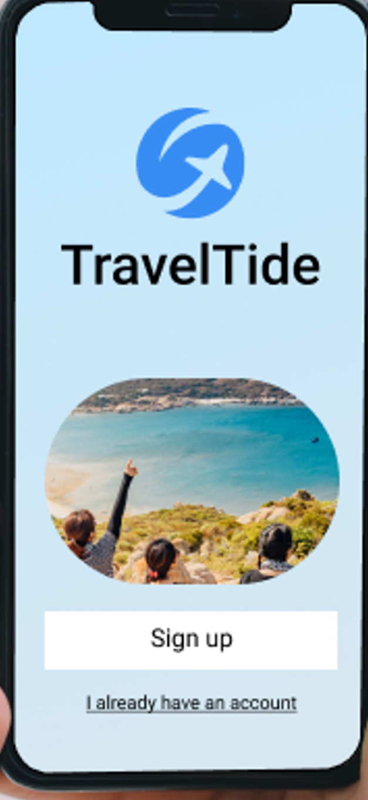

Travel
Tide
World Travel
THANKS FOR
WATCHING

